Slide 1
Extrapolation Pitfalls When Evaluating Limited Endurance Memory
Tinker Research
Rishiraj Bheda, Jesse Beu, Brian Railing, Tom Conte

Slide 2
Need for New Memory Technology
DRAM density scalability problems
  Capacitive cells formed via ‘wells’ in silicon
  More difficult as feature size decreases.
DRAM energy scalability problems
  Capacitive cells leak charge over time
  Require periodic refreshing of cells to maintain value
Notes:
There is a DRAM scalability problem, both with respect to density and energy.
Non-volatile nature of leakage means we have to periodically refresh the cells

Slide 3
High Density Memories
Magento-resistive RAM – MRAM
  Free magnetic layer’s polarity stops flipping
  ~10¹⁵ writes
Ferro-electric RAM – FeRam
  Ferrous material degradation
  ~10⁹ writes
Phase Change Memory – PCM
  Metal fatigue from heating/cooling
  ~10⁸ writes
Notes:
MRAM storage is dependent on the change in resistivity through a magnetic tunnel junction, which is set via the polarity of the ferromagnetic electrodes
FeRam storage leverages the change in capacitance of a ferroelectric thin-film to store information, where the capacitance is dependant on the polarity of the device.
Unique property of ‘Chal Go Gen Nide’ glass to set the resistance of the device.
PCM uses the resistivity difference between a high resistance amorphous state vs a low resistance crystaline state. The state is manipulated via heating and either rapid or slow cooling of the device through current-pulse duration and magnitude.

Slide 4
Background - Addressing Wear Out
For viable DRAM replacement, mean time to failure (MTTF) must be increased
Common solutions include
  Write filtering
  Wear leveling
  Write prevention

Slide 5
Write Filtering
General rule of thumb, combine multiple writes
Caching mechanisms filter access stream, capturing multiple writes to the same location, merge into single event
  Write buffers
  On-chip caches
  DRAM pre-access caches (Qureshi et al.)
Not to be confused with write prevention (bit-wise)

Slide 6
Write Filtering Example
ProcessorWrite Stream
$
Filtered Stream
L2 Cache
DRAM Cache
Mem Con
Notes:
Small fraction of original write stream is observed (benchmark dependent).
Worth noting that cold reads (page faults) are data fill actions, which are equivalent to writes in the memory cells

Slide 7
Write Prevention
General rule of thumb, bitwise comparison techniques to reduce write
Ex: Flip-and-write
  Pick shorter hamming distance between natural and inverted versions of data, then write.

Slide 8
Write Prevention Example
00000010
00000001
00000000
11111111
11111110
0
0
1
0
0
1
0
0
1
0
0
1
0
0
1
0
0
1
0
0
1
1
0
1
1
1
1
1
1
1
1
0
X
Σ
2
7
1
8
0
0
0
1
0
0
0
0
0
0
0
0
0
0
0
0
0
0
0
0
0
0
0
0
0
0
0
0
1
0
0
0
0
1
0
0

Slide 9
Write Leveling
General rule of thumb – Spread out accesses to remove wear-out ‘hotspots’
Powerful technique when correctly applied
  Uniform wearing of the device
  The larger the device, the longer the MTTF
Multi-grain Opportunity
  Word-level - Low-order bits have higher variation
  Page-level - Low numbers blocks written to more often
  Application-level – few high activity ‘hot’ pages

Slide 10
Overview
Background
Extrapolation pitfalls
  Impact of OS
  Memory Sizing and Page Faults
Estimates over multiple runs
Line Write Profile
Core take away of this work

Slide 11
Extrapolation Pitfalls
Single run extrapolation, OS and long-term scope
  Natural wear leveling from paging system
  Interaction of multiple running processes
  Process creation and termination
  A single, isolated run is not representative!
Main memory sizing and impact of high density
Benchmark ‘region of interest’
  Several solutions exist (sampling, simpoints, etc.)
Notes:
There are 3 classes of extrapolation pitfalls we discuss in our paper.

Slide 12
OS Paging
Goal
  Have enough free pages to meet new demand
  Balanced against utilization of capacity
Solution
  Actively used pages keep valid translations
  Inactive pages migrate to free list; reclaimed for future use
Reclamation shuffles translations over time!
Notes:
This happens even in isolation; Paging system still does reclaimation during execution for single workload
On process creation, new set of pages acquired each time; not identical page mapping, so naïve extrapolation fails!
Multi-process environment even more of an impact as the OS balances memory resources between dynamic process demand.

Slide 13
Impact of shuffling
Notes:
Will come back to this graph later, but wanted to show right now what this means

Slide 14
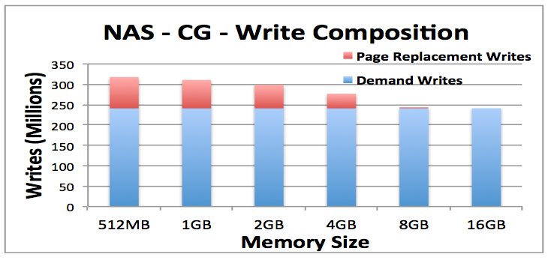
Main Memory Sizing
Artificially high page fault frequency when simulating with too little
Collision behavior can be wildly different
  Impact on write prevention results
Notes:
You really want a representative memory size-memory pressure balance when evaluating these technologies.

Slide 15
MTTF improvement with size
Unreasonable to assume device failure with first cell failure
  Device degradation vs. failure
  Larger device takes longer to degrade
Even better in the presence of wear leveling
  More memory means more physical locations to apply wear leveling across
  Assuming write frequency is fixed*, increase in size means proportional increase in MTTF
Notes:
*Reasonable to assume fixed write frequency because of off-chip bandwidth constraints

Slide 16
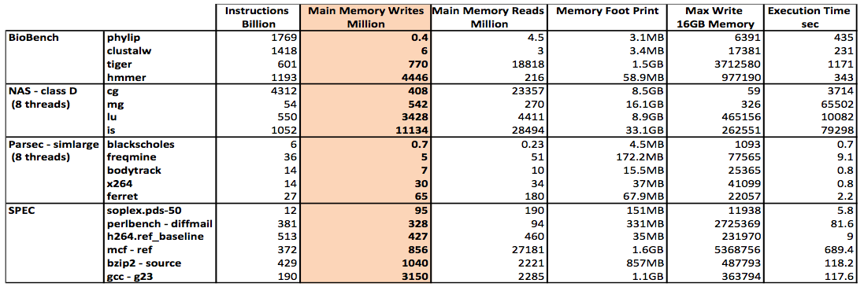
Benchmark Characteristics

Slide 17
How much does this all matter?
Short version – a lot
Two Consecutive runs increase max write estimate by only 12%, not 100%
Notes:
It matters a lot, esp. when considering paging impact, which will be focused on for the remainder of this talk
6000 write spike, all other locations ~700 writes
Extrapolation from single run assumes linear, multiplicative increase.

Slide 18
Higher Execution Count
Non-linear behavior over many more executions
  Sawtooth-like pattern due to write-spike collisions
  Lifetime estimates in years instead of months!
Notes:
It’s also worth noting that these spikes become more and more subtle as the execution count increases. This is because even a write-spike collision of 6k events has very little impact compared to the 10^8 writes required to kill a PCM cell.

Slide 19
How should we estimate lifetime?
Running even a single execution of a benchmark can become prohibitively expensive
  Apply sampling to extract benchmark write behavior
Heuristic should be able to approximate lifetime after many many execution iterations
  Line Write Profile holds the key
Notes:
We found that random sampling of 10% of the write stream yielded a less than 5% error in the overall line write profile and associated lifetime estimates.
I will now discuss line write profiles over the next few slides.

Slide 20
Line Write Profile
Can be viewed as a superposition of all page write profiles
Line Write Profile provides a summary of write behavior
Physical Address
Page ID
Line ID
Line Offset
Line ID

Slide 21
Line Write Profile
For every write access to physical memory
  Extract LineID
  For a Last Level Cache with Line Size of 64 Bytes
    A 4KB OS Page contains 64 cache lines
    Use a counter for each of these 64 lines
    Increment counter by 1 for every write that reaches main memory

Slide 22
Line Write Profile – cg (Full Run)

Slide 23
Line Write Profile – cg (100 Billion Instructions)

Slide 24
Using Line Write Profile
As the number of runs approaches infinity
  If every physical memory page has equal chances of being accessed, then
    Every physical page tends towards the same write profile
    At this point, the lifetime curve reaches a settling point
The maximum value from the Line Write Profile can then be used to accurately estimate lifetime in the presence of an OS.

Slide 25
So is wear endurance is a myth?
Short answer – no
Applications that pin physical pages will not exhibit natural OS wear leveling
Security threats are still an issue
  And the OS can easily be bypassed to void warranty
  Hardware wear leveling solutions can be low cost and effective

Slide 26
Final Take Away
Wear endurance research should not report results that do not take multi-execution, inter-process and intra-process OS paging effects into account.
Techniques that depend on data (write prevention) should carefully consider appropriate memory sizing and page fault impact
Ignoring these can result in grossly underestimating baseline lifetimes and/or grossly overestimating lifetime improvement.

Slide 27
Thank You
Questions?

